Slide 1

Android Developer Virtual Internship
by
Nasreen S
Roll No. 224G1A3361
Department of Computer Science and Engineering (AI&ML)
Srinivasa Ramanujan Institute of Technology
(Affiliated to JNTUA & Approved by AICTE) (Accredited by NAAC with ‘A’ Grade & Accredited by NBA (EEE, ECE & CSE)
Rotarypuram Village, B K Samudram Mandal, Ananthapuramu – 515701.
2024 - 2025

Slide 2
Contents
Course Objective
Introduction
Technology
Applications
Modules
Real Time applications
Learning outcomes
GitHub Link
Queries

Slide 3
Course objective
Deep Dive into Android Architecture Components: Explore essential Android architecture components, including LiveData, ViewModel, and Room, to build robust and maintainable applications
Enhance Debugging and Testing Skills: Learn advanced debugging techniques and implement unit tests and UI tests using tools like JUnit and Espresso, ensuring code reliability and performance.
Implement Responsive Design: Understand and apply principles of responsive design and adaptive layouts to create applications that function seamlessly across a variety of devices and screen sizes.
Access APIs and Data Management: Gain hands-on experience in integrating RESTful APIs and handling data management using libraries like Retrofit and Glide for effective network operations.
Familiarize with Version Control Systems: Use Git for version control, enhancing collaborative development practices and understanding how to manage code changes effectively.

Slide 4
Introduction
Google Central to Android's development is Google, offering core software, services, and updates. The Google Play Store serves as the official app distribution platform, granting users access to millions of applications. The user interface of Android is tailored for touch gestures, featuring a customizable home screen and support for widgets, ensuring an interactive and intuitive experience.
From Eduskills Foundation, AICTE launches a Virtual Internship on Google Android Virtual Internship.
The main aim of this is to gain insights on Android applications

Slide 5
Technology
1.Android Studio: The official integrated development environment (IDE) for Android development.
2.Java/Kotlin: The primary programming languages for Android development.
3.XML: Used for designing layouts and UI components.
4.Firebase: Google's mobile development platform for back-end services like authentication, cloud storage, and database management.
5.APIs & Libraries: Tools like Retrofit, Glide, Picasso, and others for networking, image loading, and more.
6.Google Play Store: Experience with the submission and publishing process.

Slide 6
Modules
Module 1: Android Basics
1. Understand Android fundamentals (components, lifecycle, permissions).
2. Set up Android Studio and development environment.
3. Build and run first Android app.
Module 2: User Interface and User Experience
1. Design intuitive user interfaces.
2. Implement UI components (layouts, views, widgets).
3. Handle user input and events.
Module 3: Data Storage and Management
1. Understand data storage options (SQLite, Room, SharedPreferences).
2. Implement data storage and retrieval.

Slide 7
Modules
Module 4: Networking and APIs
1. Understand HTTP networking and APIs.
2. Implement API calls using Retrofit or OkHttp.
Module 5: Advanced Topics
1. Implement location-based services (Google Maps).
2. Use Firebase services (Authentication, Realtime Database).
Module 6: Testing and Debugging
1. Write unit tests and UI tests.
2. Use Android Debug Bridge (ADB).
3. Debug and troubleshoot apps.

Slide 8
Real time applications
1.Ride-Sharing Apps(e.g.,Uber,Lyft)
2.Food Delivery Apps(e.g.,DoorDash,Grubhub)
3.Weather Apps with Real-Time updates(e.g.,Accu Weather)
4.Home Security Apps with Live Camera Feeds(e.g.,Nest,Ring)
5.Emergency Services Apps(e.g.,SOS Apps)
6.Health and Fitness Apps with GPS(e.g.,Strava,Runkeeper)
7.E-Commerce application(e.g.,Amazon,Flipkart)
8.Social Media(e.g.,Instagram)

Slide 9
Learning outcomes
1. Develop a comprehensive understanding of Android development.
2. Build multiple Android apps.
3. Prepare for Google Android Developer Certification.
4. Enhance career prospects in Android development.
5. Stay updated with latest Android trends and technology

Slide 10
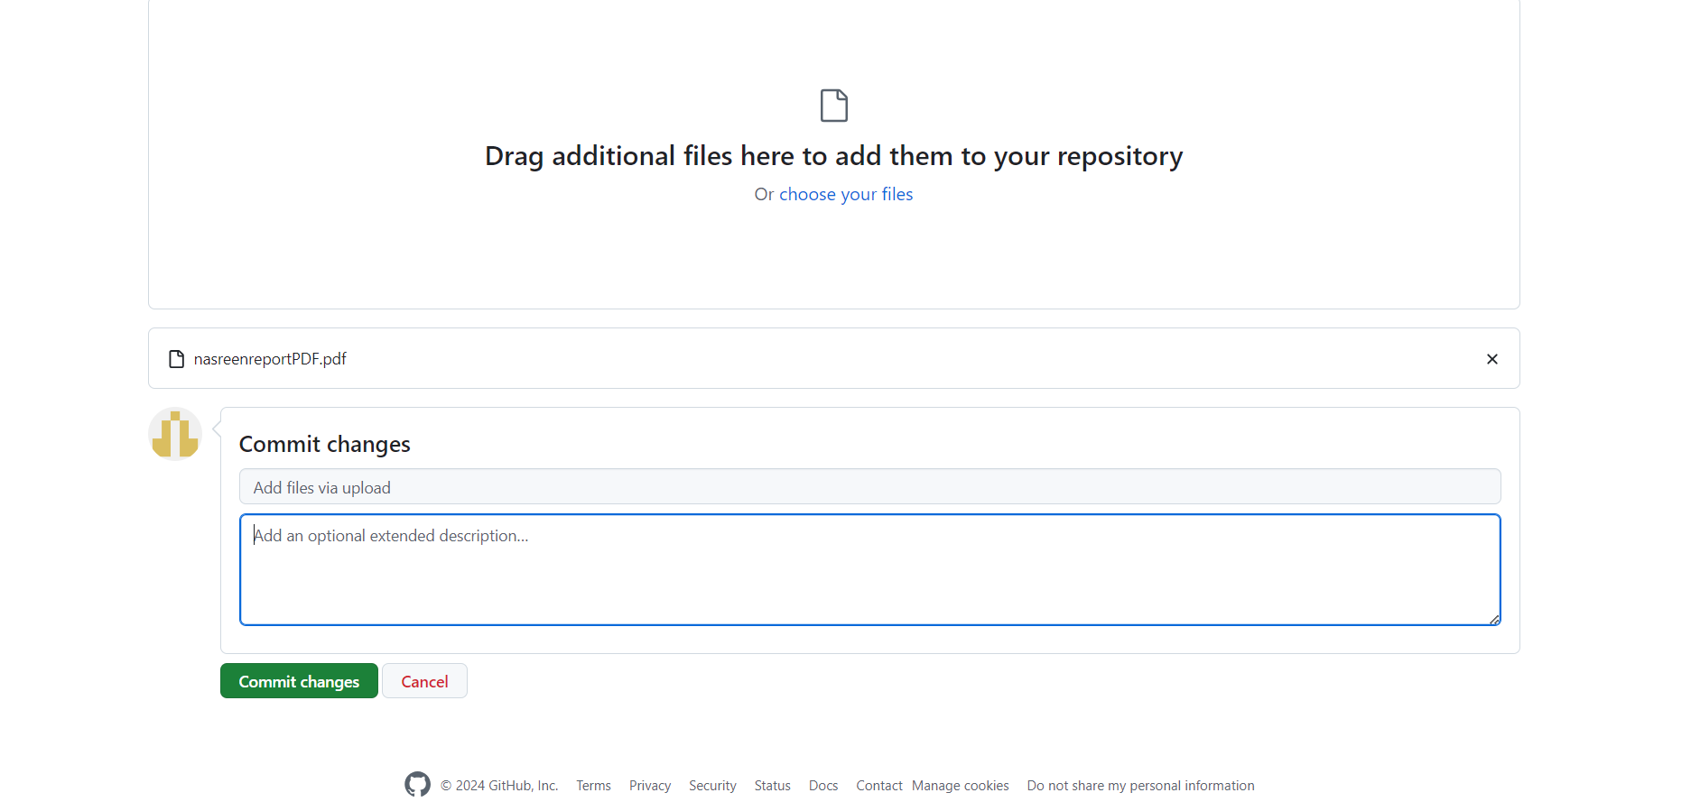
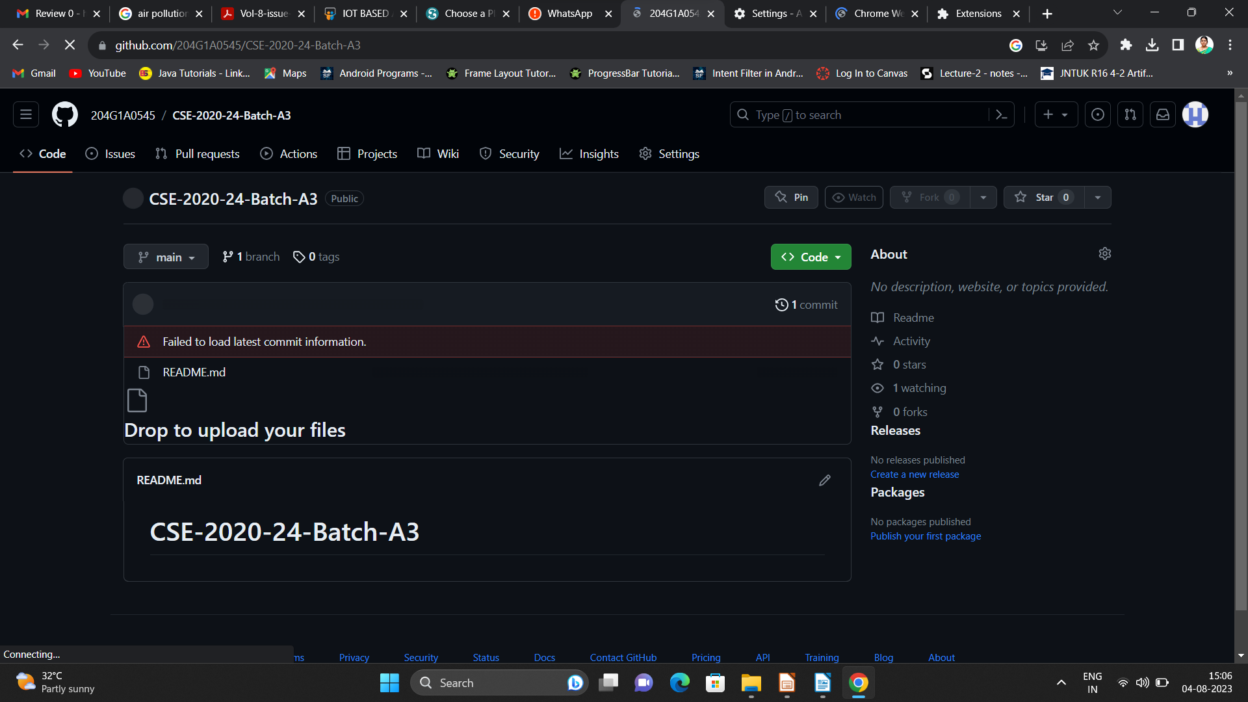

Git Hub Dashboard
Repository Name Like: Summer Internship - I
Under that include document, presentation and Certificate(Pdf).

Slide 11
Any Queries?

Slide 12
Thank You!!!

